Slide 1
BLIND SOURCE SEPARATION AND AUDIO CLASSIFICATION
Team Members- Natasha Lalwani & Mariachiara Acconcia

Slide 2
PROBLEM STATEMENT

Slide 3
Description of our Problem Statement
Our project consists of mainly two parts:
Blind Source Separation: Approach this part with the implementation of FastICA. We will combine the audio of individual speakers and then feed that mixed audio signal through the FastICA model.
Classification: Explore Neural Networks like Artificial Neural Network and Convolutional Neural Network. We will feed the results obtained from the FastICA model to our classification models

Slide 4
RELATED WORK

Slide 5
Blind Source Separation based on FastICA
Implemented improved Fast fixed-point algorithm (FastICA)
Worked on processed mixed-signal collected from laboratory
FastICA improves the convergence rate of Independent Component Analysis, while it does not affect signal separation accuracy. This algorithm is more accurate and more robust than the principal component analysis algorithm.

Slide 6
Emotional Speaker Recognition based on Machine and Deep Learning
Implemented :
5 Machine Learning Models; Logistic Regression, Support Vector Machine, Random Forest, XGBoost, and k-Nearest Neighbor
3 Deep Learning Models; Long Short-Term Memory network, Multilayer Perceptron, and Convolutional Neural Network
They worked on the Ryerson AudioVisual Database of Emotional Speech and Song (RAVDESS) dataset.
Among the Machine Learning models, Logistic Regression model outperformed other models whereas among Deep Learning Models, MLP outperformed other models.
Holistically, MLP had the best performance with an accuracy of 92%

Slide 7
Speech Command Recognition Using Deep Learning
Implemented Convolutional Neural Network (CNN) to extract features
Worked on Speech Command Dataset collected from Google’s Tensorflow and AIY teams.
Spectrograms are fed to the CNN model. The role of the CNN is to reduce the spectrograms into a form which is easier to process, without losing features which are critical for getting a good prediction, this is important in massive datasets.
They obtained an accuracy of 96%

Slide 8
DATA DESCRIPTION

Slide 9
DATASET
Speaker Recognition Audio Dataset
This dataset includes 50 speakers audio data with length more than 1 hour for each. Each file contains a single audio source coming from one of the 50 speakers. Our idea is to combine a few of these single audio data and mix up the sources, in order to test our model for separating the sources.

Slide 10

DATA ACQUISITION
We used the Kaggle API to get our data.
The data is public and doesn’t require a private API key and there is no hard limit on rate as well.
The only requirements in order to be able to use Kaggle API are installing and importing the Kaggle module, and the Kaggle APIs modules.

Slide 11

DATA PRE-PROCESSING
The data we are going to use for the model implementation is an audio file that contains multiple (for our project we have chosen 8 speakers) source signals.
Below an example of the audio file we obtained by mixing eight different speakers’ samples using random mixing matrix.
This mixed audio file is what we used for our implementation of the FastICA.
Mixed Audio File

Slide 12
OUR APPROACH

Slide 13
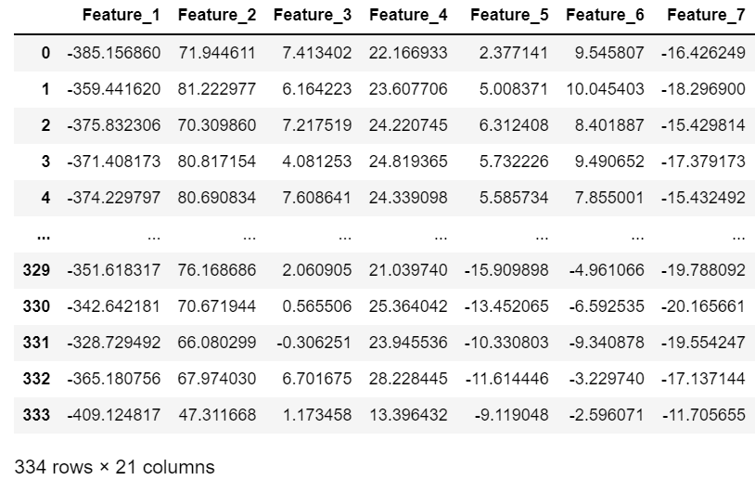
FEATURE EXTRACTION
Mel Frequency Cepstral Coefficients
The shape of the vocal tract determines any sound produced by humans (including tongue, teeth, etc.). If this shape is correctly determined, any sound produced can be accurately represented. The envelope of the time power spectrum of a speech signal represents the vocal tract, and MFCC accurately represents this envelope.
The Mel scale relates a pure tone's perceived frequency, or pitch, to its actual measured frequency.
Mel(f) = 2595 log(1 + f 700 )
Notes:
A frequency measured in Hertz (f) can be converted to the Mel scale using the following formula:
With the Librosa module we loaded every single .wav file, and extracted the MFCC features for each of them. We then computed the mean of these features, obtaining 20 MFCCs for each audio file, and inserted these features in a dataframe along with the $Speaker$ $Label$.

Slide 14
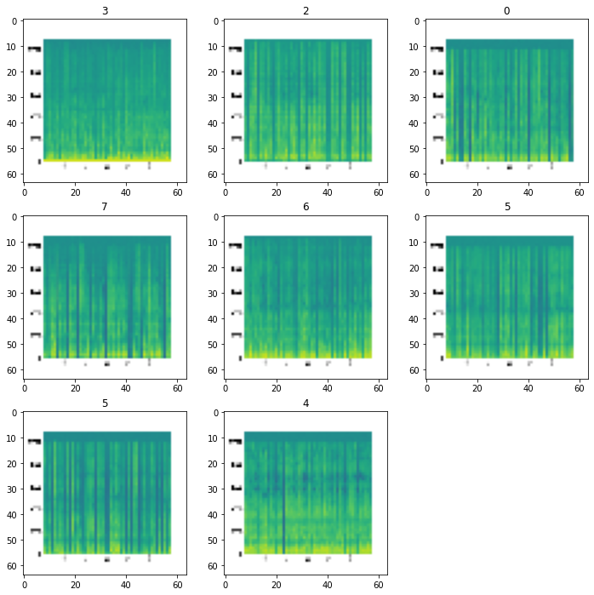
FEATURE EXTRACTION
Spectrograms
Spectrograms are a visual representation of the spectrum of frequencies of a signal as it varies with time.
We used Pylab’s module to create spectrograms for each audio file from all the eight different speakers, which we then used as input data for our model. For the spectrograms, we changed the NFFT value from the default 256 to 51200.
Notes:
The NFFT value of 256 takes Fourier Transforms over 0.01 second of audio, which shows it is highly dependent on what the speaker is saying but it is not what we are concerned with. We are mainly concerned with the characteristics of the speaker's voice for “speaker classification”, hence extending the time frame by increasing the NFFT value.

Slide 15
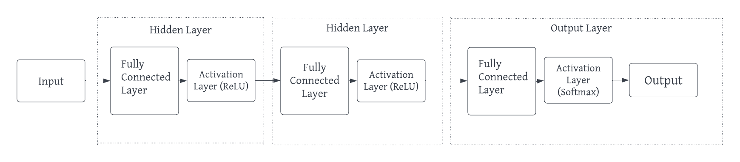
ANN MODEL

Slide 16
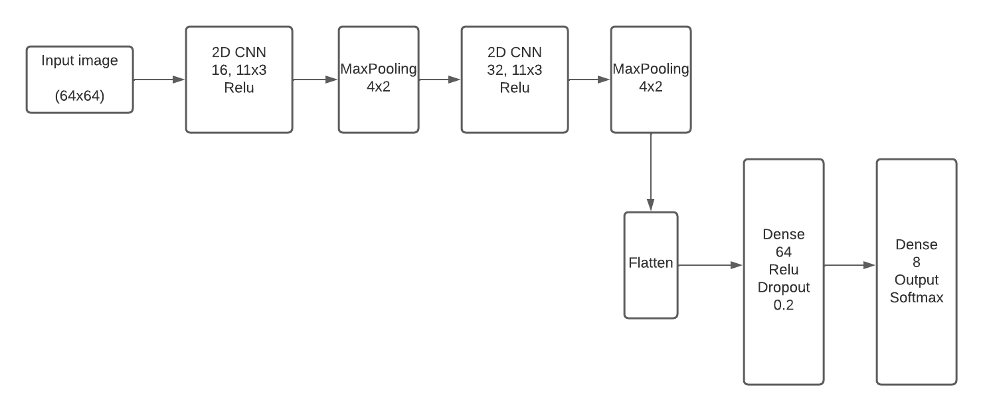
CNN MODEL

Slide 17
FastICA
For the second part of this study, we decided to create our own mixed signals, by simply taking one audio sample from each speaker, and combine them all together using a randomly generated mixing matrix. By using eight different audio files and a matrix with dimensions 8x8, we obtained eight different mixed signals, all with different weights associated to each speaker, and we fed these signals to our BSS algorithm, the FastICA.
We used the FastICA algorithm from the “scikit-learn” python module, and set the number of components to 8. From the implementation of this algorithm on the mixed signals, we obtained eight different unmixed components, which represent the eight different speakers.

Slide 18
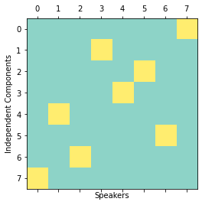
COMBINING THE MODELS
After training the classification model on all the individual audio samples, and obtaining independent components from the mixed audio signals with the FastICA, we wanted to classify each independent component and associate it to one of the eight speakers.
We took the classification parameters obtained from training the model, and applied them to all the independent components dataframe resulted from the BSS technique, in order to predict the speaker talking in each independent audio file.
The matrix shows the one-hot encoding representation of the mentioned predictions array, which represents the association between the independent components (on the y-axis) and the speakers (on the x-axis).

Slide 19
RESULTS AND OBSERVATION

Slide 20
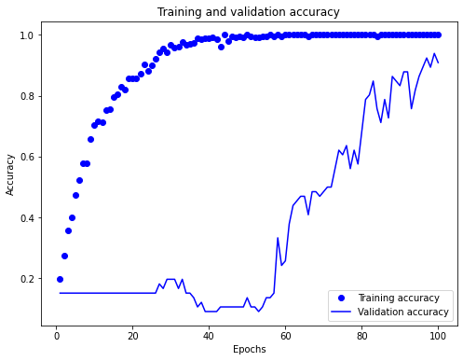
CNN MODEL
Convolutional Neural Network gives us good results in terms of accuracy but, by looking at the plot on the right, it is clear that, while the training accuracy increases at a consistent rate until it reaches 100% after about 50 epochs, the validation accuracy is not improving at a steady pace at every iteration, but it is drastically changing (either increasing or decreasing) at every epoch. Even with these unstable rapid changes, the overall behavior of the curve is positive, and the average accuracy increases after 100 iterations, obtaining a final accuracy of 90.91%. This curve highlights the limitation of our CNN model, which might be overfitting on the training set. This problem could be caused by the fact that our training dataset, the set of spectrograms from the audio files, is not large enough for the CNN, and we would need more samples in order to obtain a better performance.

Slide 21
ANN MODEL
The Artificial Neural Network classification model was the one that gave us better results in terms of performance. The table on the right shows the results obtained for the evaluation metrics of Accuracy, Precision, and Recall.
Because of the better results obtained from the ANN classification model, rather than from the CNN, we decided to move forward towards the final part of this project i.e., speaker recognition, using this algorithm (ANN).
 | Accuracy | Precision | Recall
Training Set | 1 | 1 | 1
Validation Set | 0.97 | 0.97 | 0.97

Slide 22
Speaker Recognition
After the implementation of the FastICA, we had eight independent components that we needed to match to their corresponding speaker. We managed to do this last step of Speaker Recognition problem by applying the parameters obtained from the ANN to the Independent Components dataset, and we showed the results in the form of a matrix (next slide).
However, this matrix did not tell us precisely if our predictions were correct or not, therefore, based on the matches shown in the matrix, we decided to plot the frequency wave of each independent component and their corresponding speaker's audio file. As we can see in figure shown on the next slide, all the waves on the left match the ones on the right, stating that our model predictions were exact.

Slide 23
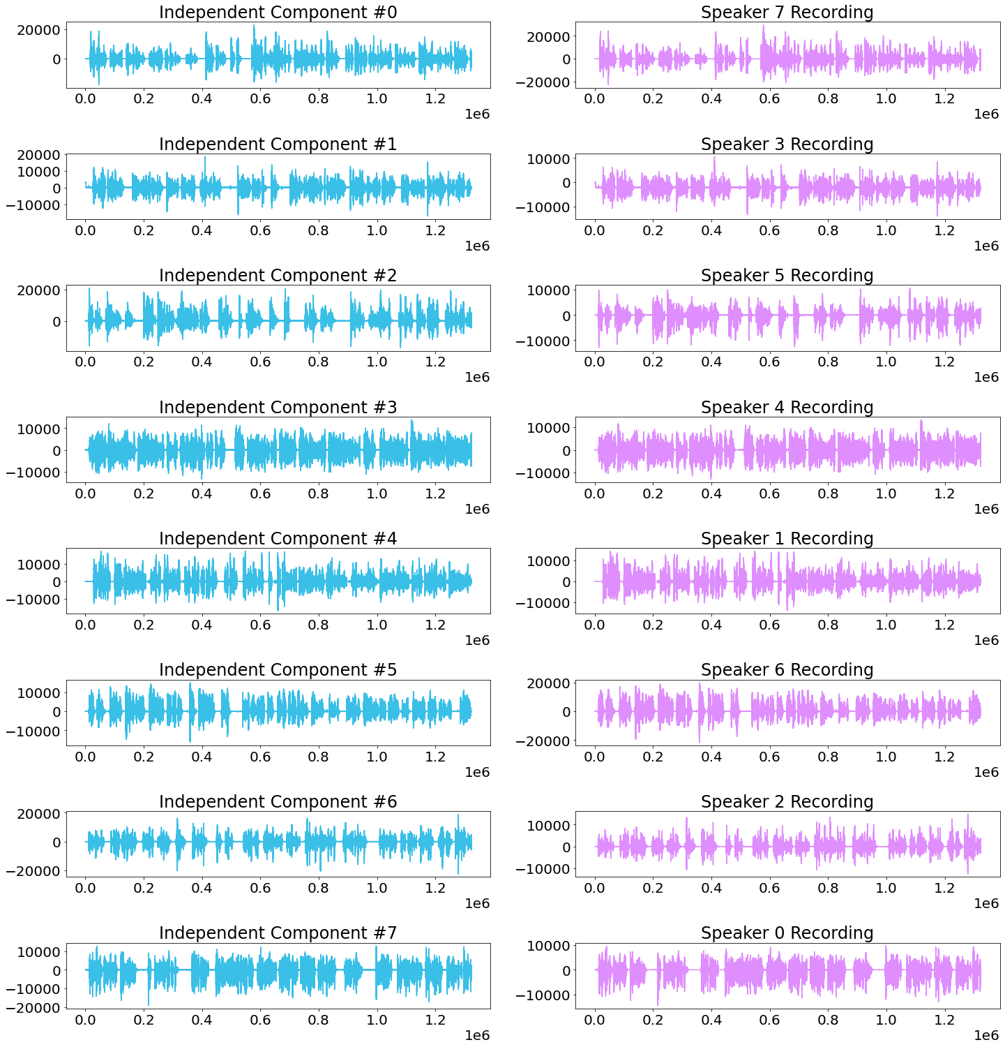
Speaker Recognition

Slide 24
Speaker Recognition
Independent Component 0
Independent Component 4
Original Speaker 7
Original Speaker 1

Slide 25
LIMITATIONS AND
FUTURE SCOPE

Slide 26
Limitations and Future Scope
When working with our model we realized one constraint is the size of our dataset because of which our CNN model did not exactly perform the way we had expected it to. Each speaker has around 30-50 audio files; which means in total we have 240-400 spectrograms and that is not enough to train and test a model.
On further analysis we realized that melspectrograms are better than spectrograms. The linear audio spectrogram is best for applications in which all frequencies are equally important, whereas mel spectrograms are preferable for situations in which human hearing perception must be modeled. Audio classification programs benefit from Mel spectrogram data. Hence, in the future, instead of using spectrograms, melspectrograms can be used in order to train the CNN model.
We could also train a Recurrent Neural Network to classify the speakers as they have shown great results as well.

Slide 27
THANK YOU!

